Slide 1
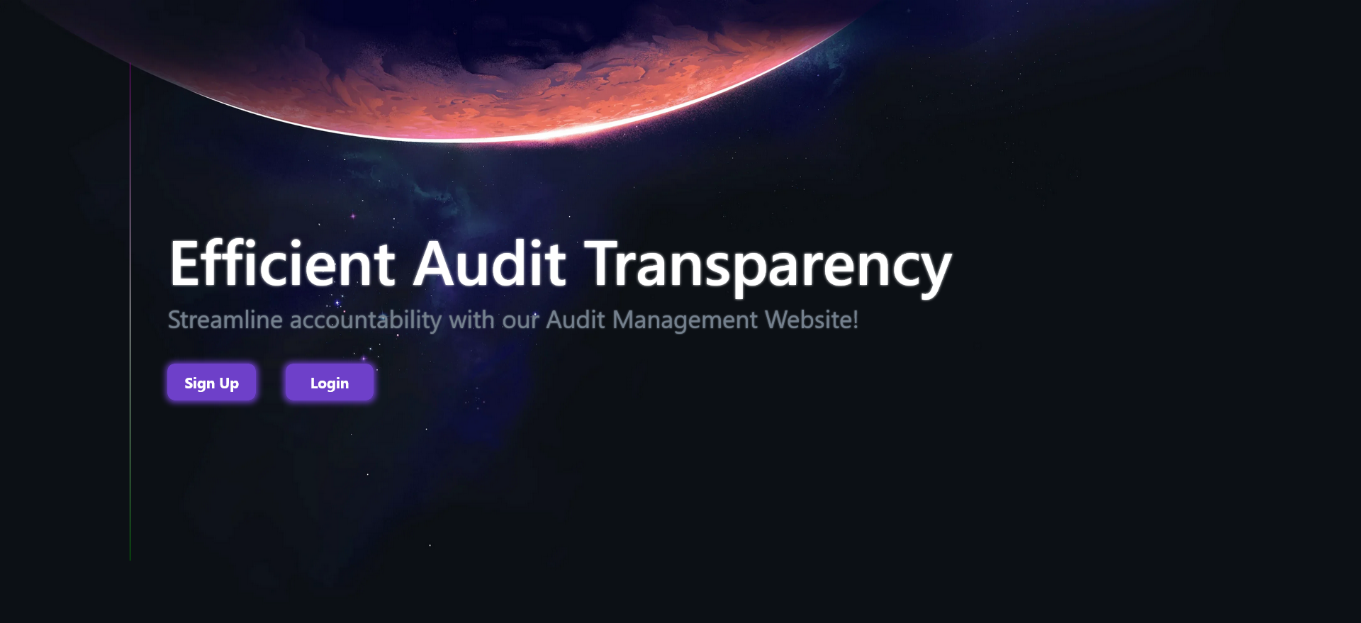
TEAM BROCODE
KUNAL SINGLA
2. ADITYA KUMAR
3. ASHUTOSH TANEJA
4. VIDIT SARIN
5. MAYANK UPPAL

Slide 2
STGI HACKATHON
1
OVERVIEW
The main objective of our project was to automate the audit system.
In case of any error the same set of audit is replicated and used to work in a lower test simulator environment.
The entire team must split up into groups and the following task were completed individually by each of sub groups:-
UI/UX Designing , Attribute Form Designing , Powerpoint Creation and Presentation
Created Frontend using React.Js , Bootstrap.
Backend and Database Formation.
TEAM: BROCODE

Slide 3
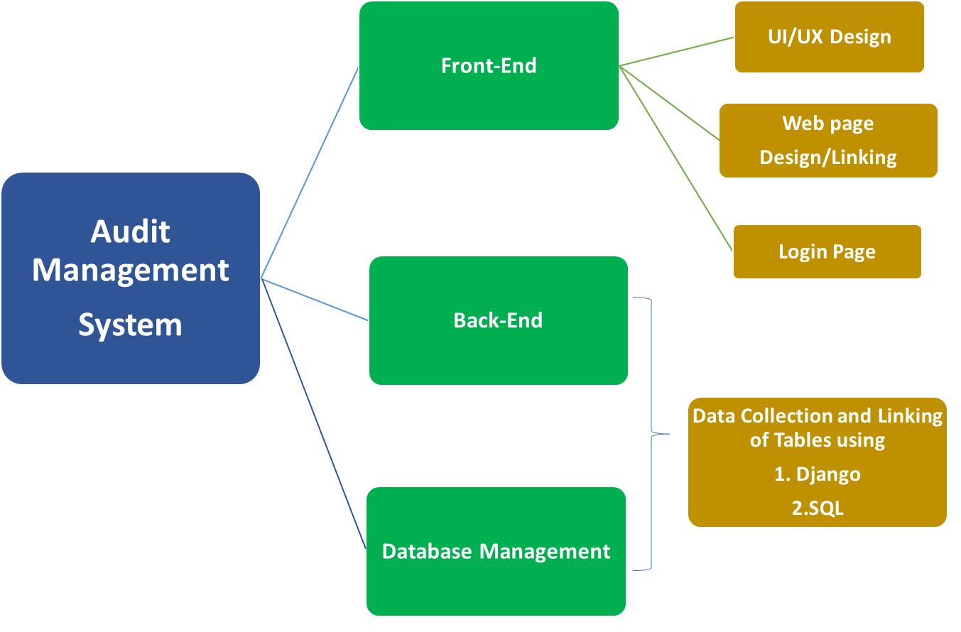
STGI HACKATHON
1
FLOW CHART (APPROACH)
TEAM: BROCODE

Slide 4
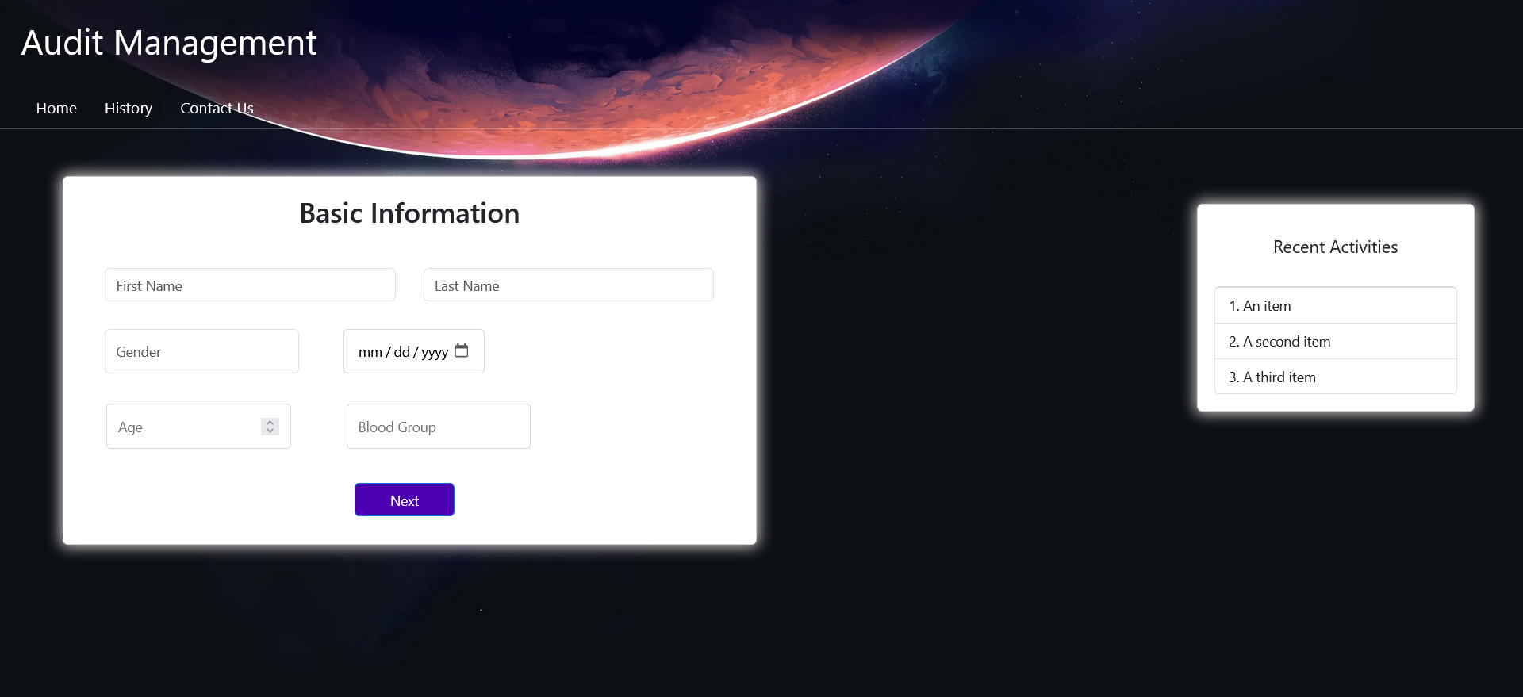
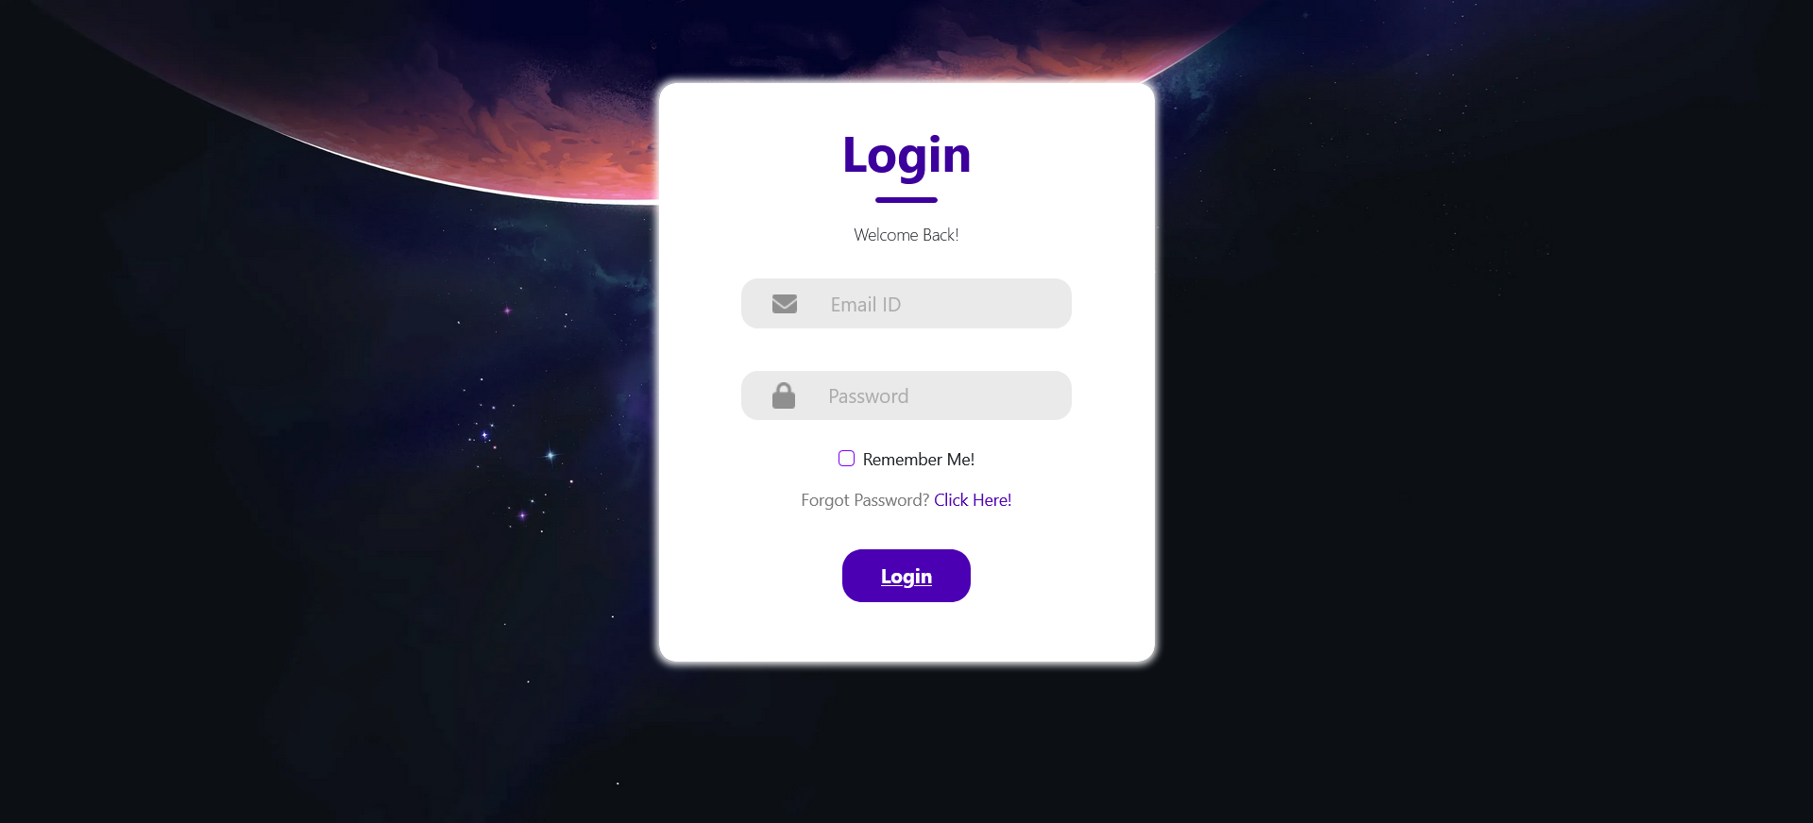
STGI HACKATHON
1
Frontend is made up of React.js and Bootstrap – CSS framework
It consists of:
Login/SignUp Page – it authenticates the iuser and takes him to the dashboard
Dashboard – It includes history tab and various other tabs like home , contact support
Also there is a special column of Recent Commits where all the changes committed are recorded and compared.
FRONTEND
TEAM: BROCODE

Slide 5
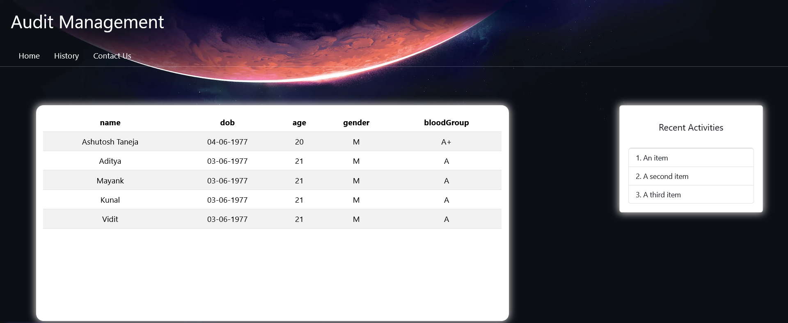
STGI HACKATHON
1
BACKEND
Learned Django from scratch and made the website responsive, as it stores the the data input given by the user in MYSQL server.
Integrated the Student Form with MYSQL.
TEAM: BROCODE

Slide 6
STGI HACKATHON
1
Phone
Address
DATABASE MANAGEMENT
Name
Father's name
Personal info
Basic Info
Gender
DoB
Mother's name
Students
Email Id
Blood group
Age
Class
Section
School info
Roll No.
Admission
TEAM: BROCODE

Slide 7
STGI HACKATHON
1
SOLUTIONS
MARKET MODELLING
Efficiency increases , more customer oriented.
Checking for its inclination towards its defined objectives.
Analysis through reports.
Reduces administrative and IT burdens.
Real Time Tracking(Status Tracking)
Target Audience
Internal Auditors.
Operation and Process Managers.
Educational institutions and government agencies.
Healthcare institution.
TEAM: BROCODE

Slide 8
STGI HACKATHON
1
THANK YOU
TEAM: BROCODE

